Slide 1
SMART WATER FOUNTAIN

Slide 2

Smart Water Fountain
Smart water fountains are innovative devices combine water filtration with advanced technology. They offer touchless, hands-free operation and often feature sensors for user interaction and maintenance alerts. Connectivity options enable remote monitoring, data analytics, and customization. These fountains are ideal for environments like offices and public spaces, promoting water quality, hygiene, and sustainability. They also encourage the use of reusable containers, reducing the need for single-use plastic bottles.

Slide 3
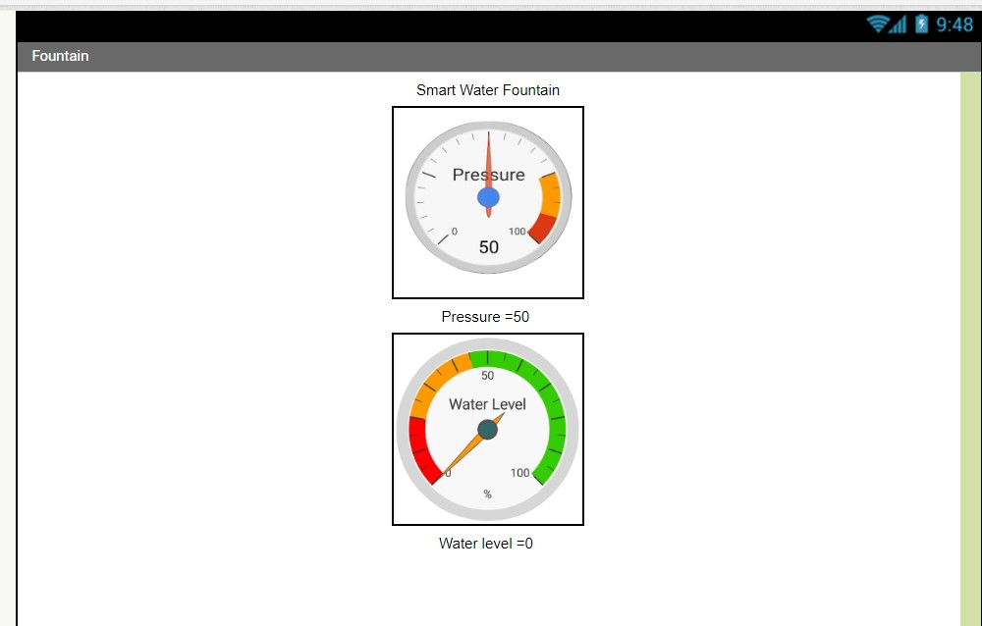
MIT APP INVERTER

Slide 4
ABOUT BLYNK
Blynk is a user-friendly Internet of Things (IoT) platform that simplifies the process of creating, controlling, and monitoring IoT projects. With its mobile app, Blynk enables users to design custom dashboards featuring widgets like buttons, sliders, and graphs. This platform supports a wide range of hardware, from microcontrollers to single-board computers, and offers cloud connectivity for remote access and control. Additionally, it seamlessly integrates with various IoT services and can be hosted on a user's own infrastructure. Blynk is favored by makers, hobbyists, and professionals for its ease of use in creating IoT applications, including home automation and remote monitoring, making it a valuable tool for a broad range of projects.

Slide 5
ABOUT MIT INVERTER APP
MIT App Inventor is a versatile, user-friendly platform that empowers individuals with little to no programming experience to create mobile applications for Android devices. Developed by the Massachusetts Institute of Technology (MIT), App Inventor uses a visual, block-based coding interface that simplifies app development. Users can design apps by snapping together pre-defined code blocks that represent various functions and features. The platform provides a range of tools to create interactive and custom mobile apps, including games, educational applications, utilities, and more. MIT App Inventor is particularly popular in educational settings, helping students and beginners gain valuable experience in app development while also serving as a valuable resource for prototyping and creating practical, functional apps without the need for extensive programming knowledge. Its open-source nature further encourages a collaborative and creative community for app development.

Slide 6
THANK YOU

